Slide 1
Linear Flow of Slightly Compressible Fluids
From Equation 6-6
It can be modified to
Substituting the above relationship in Darcy’s equation gives

Slide 2
Just apply the above integraiton

Slide 3
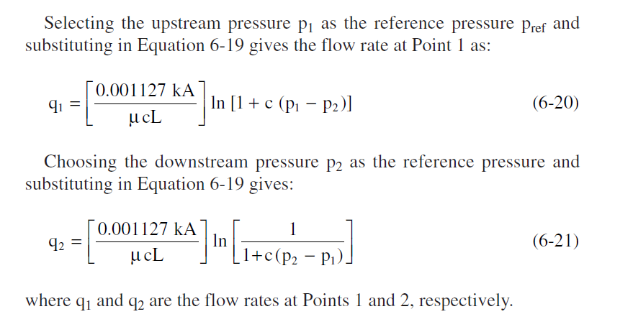

Slide 4
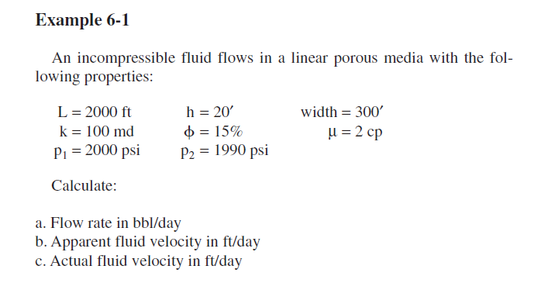

Slide 5
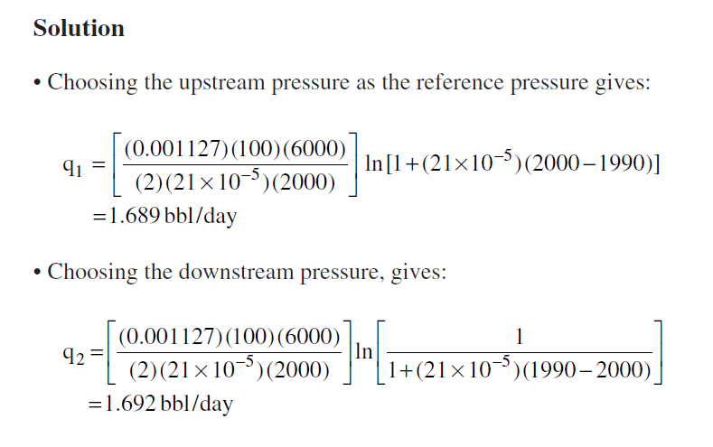
Where the change of folw comes from ??

Slide 6
Linear Flow of Compressible Fluids (Gases)
For a viscous (laminar) gas flow in a homogeneous-linear system

Slide 7
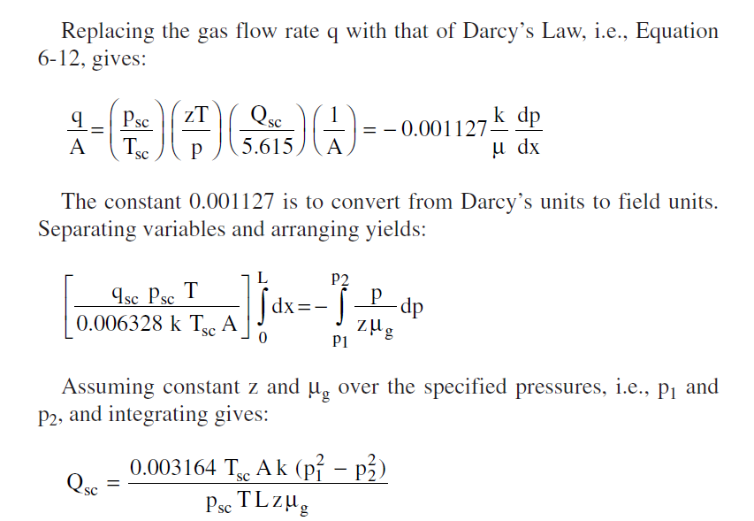

Slide 8
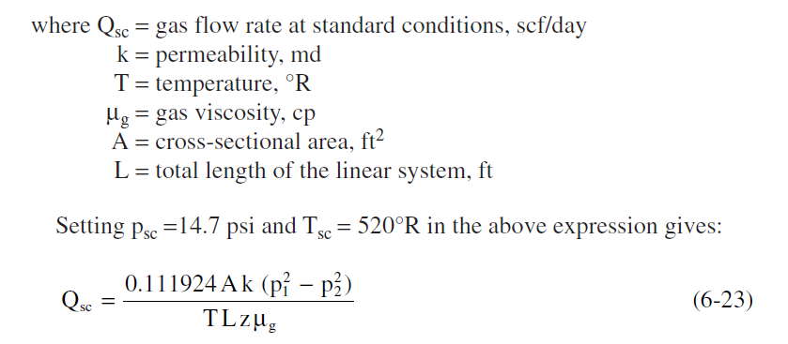
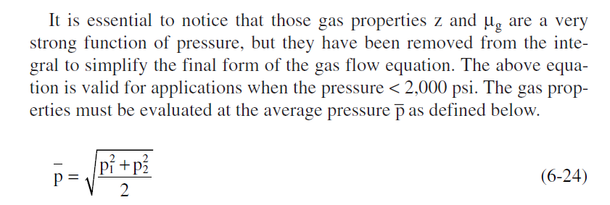

Slide 10
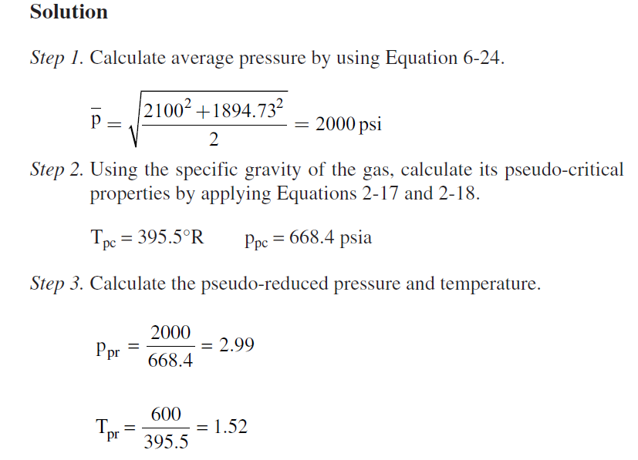
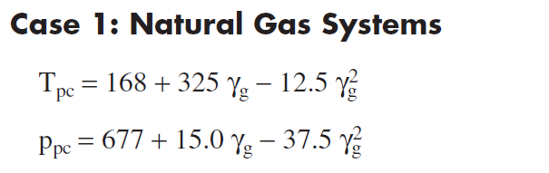

Slide 11
